Slide 1
Microsoft Visual C++

Slide 2
Microsoft Visual C++ 6.0
Remove Hide MS-DOS File extensions to ensure that you can see file extensions in MCVC++ such as .cpp
Screen Elements
3 parts (view pane, document window, debug ..build window)
Close and open above windows

Slide 3
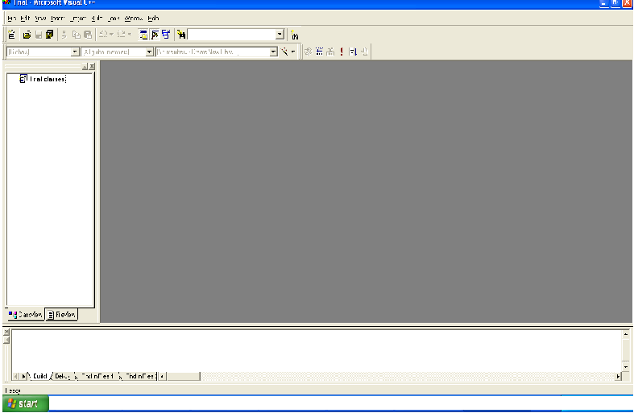
New Project
Document window (source files/help files)
View pane
Two tabs: Class view and file View
More tabs: Build, Debug

Slide 4
Microsoft Visual C++ 6.0
Single File Programs (File exist/New File)
No project should be open
Click File Menu
if Close Workspace is active (not grayed) click it to close it

Slide 5
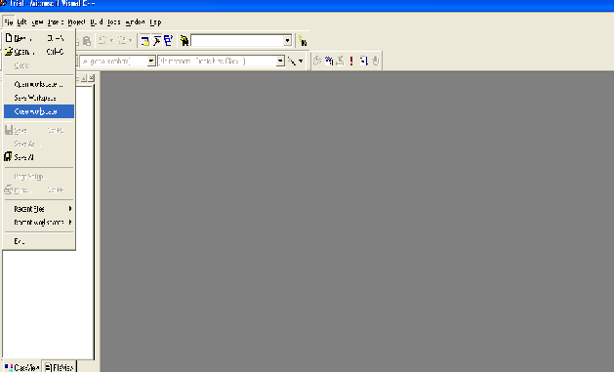
Close workspace before opening a new file

Slide 6
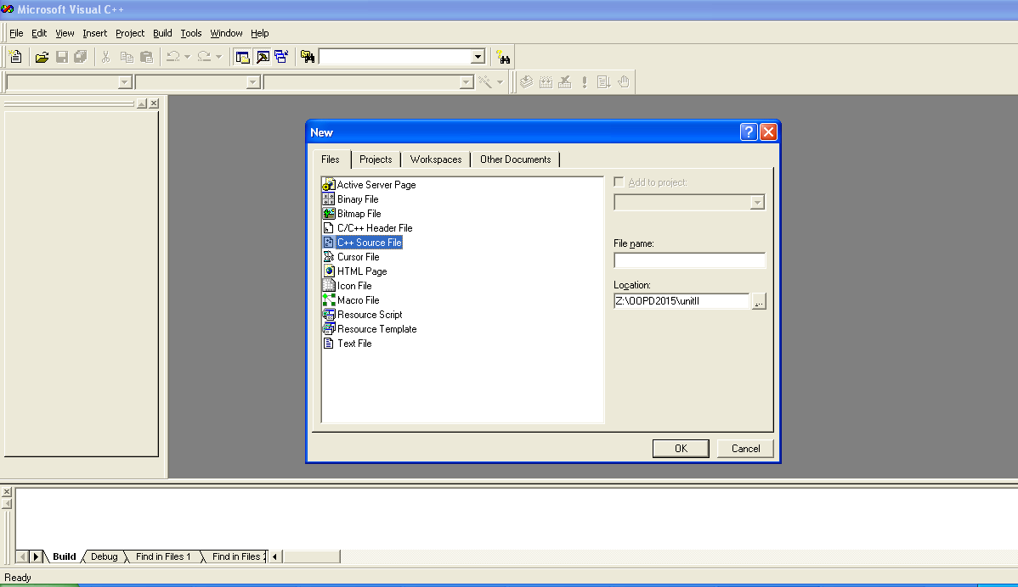
New File

Slide 7
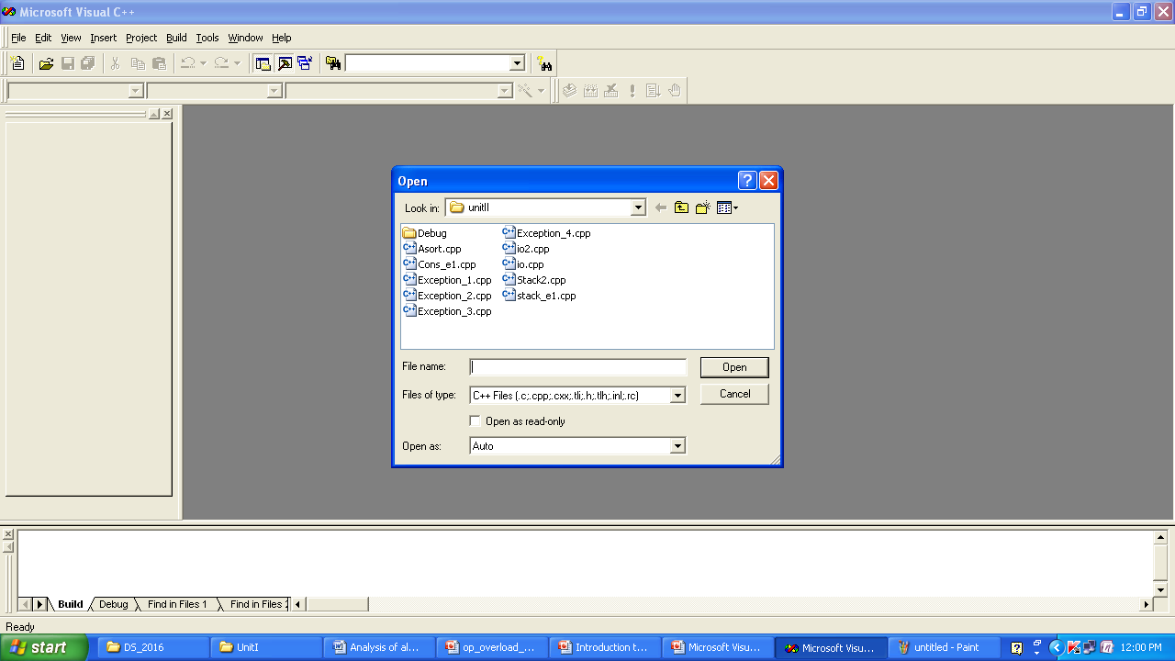
Open an existing file

Slide 8
Compiling and Building
Select Build Menu →Build
To run select Build-→Execute

Slide 9
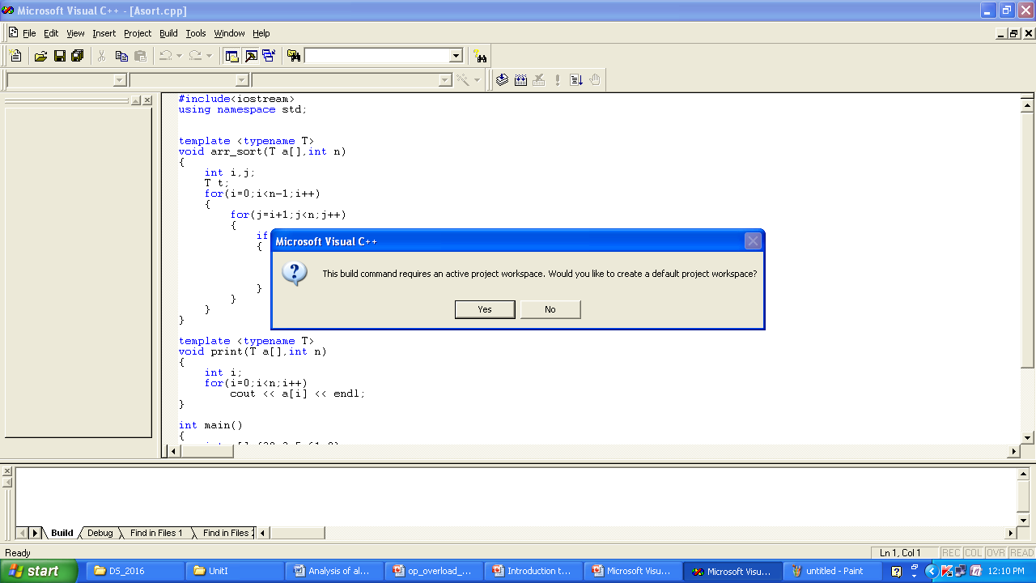
Building and Compiling Files
Click on yes

Slide 10
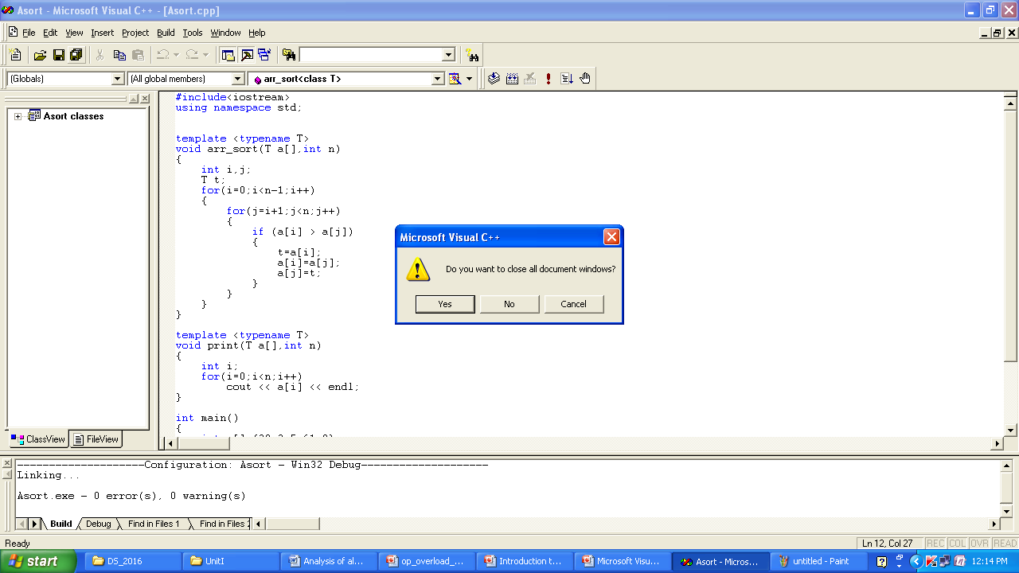
Closing
Click yes ; while closing

Slide 11
Errors
Will appear in the Build window at the bottom of the screen
Double-click on the error line and an arrow will appear next to the line containing the error in the source file
OR position the cursor on the error number in the build window and press F1 for help

Slide 12
Microsoft Visual C++ 6.0 cont…
Debugging
Single stepping
press F10(steps over functions) key/F11 (steps through functions)
switch judiciously between them
watch variables
BreakPoints
allows the program to stop at any arbitrary location when the program is running at full speed
Right click>Insert/Remove

Slide 13
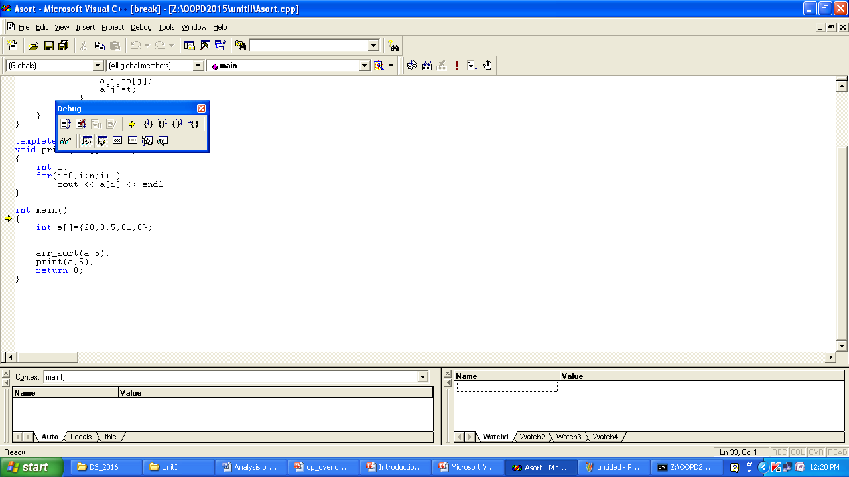
Debugger/Press F10 key

